Slide 1

PICLE: TLB Prefetcher for Inter-CU Locality Exploitation
Rajesh Shashi Kumar
Lipika Garg
Vishnu Ramadas
Rutwik Jain
Notes:
With chiplet-based GPU’s around the horizon, non-uniform TLB access is a growing concern. In this work, we investigate a monolotithic GPU TLB implementation to see how we can exploit locality and prefetching to improve TLB look performance.

Slide 2
Outline
Introduction
Virtual Memory in GPUs
Motivation and Background
Valkyrie: Exploiting Inter-TLB locality
Methodology
Results
Summary and Project Learnings
757 Project: TLB Prefetcher for Inter-CU Locality Exploitation

Slide 3
Introduction to GPU Virtual Memory
Unified Memory (UM) in CUDA terminology and Shared Virtual Memory (SVM) in OpenCL terminology
Advantages of GPU VM
Eliminate the need to perform explicit memcpys as GPU driver and runtime handle page transfers to/from GPU
Support oversubscription of memory
Support pointer-based semantics between CPU and GPU
Lower programmer burden by managing CPU-to-GPU and GPU-to-GPU data transfers
757 Project: TLB Prefetcher for Inter-CU Locality Exploitation

Slide 4
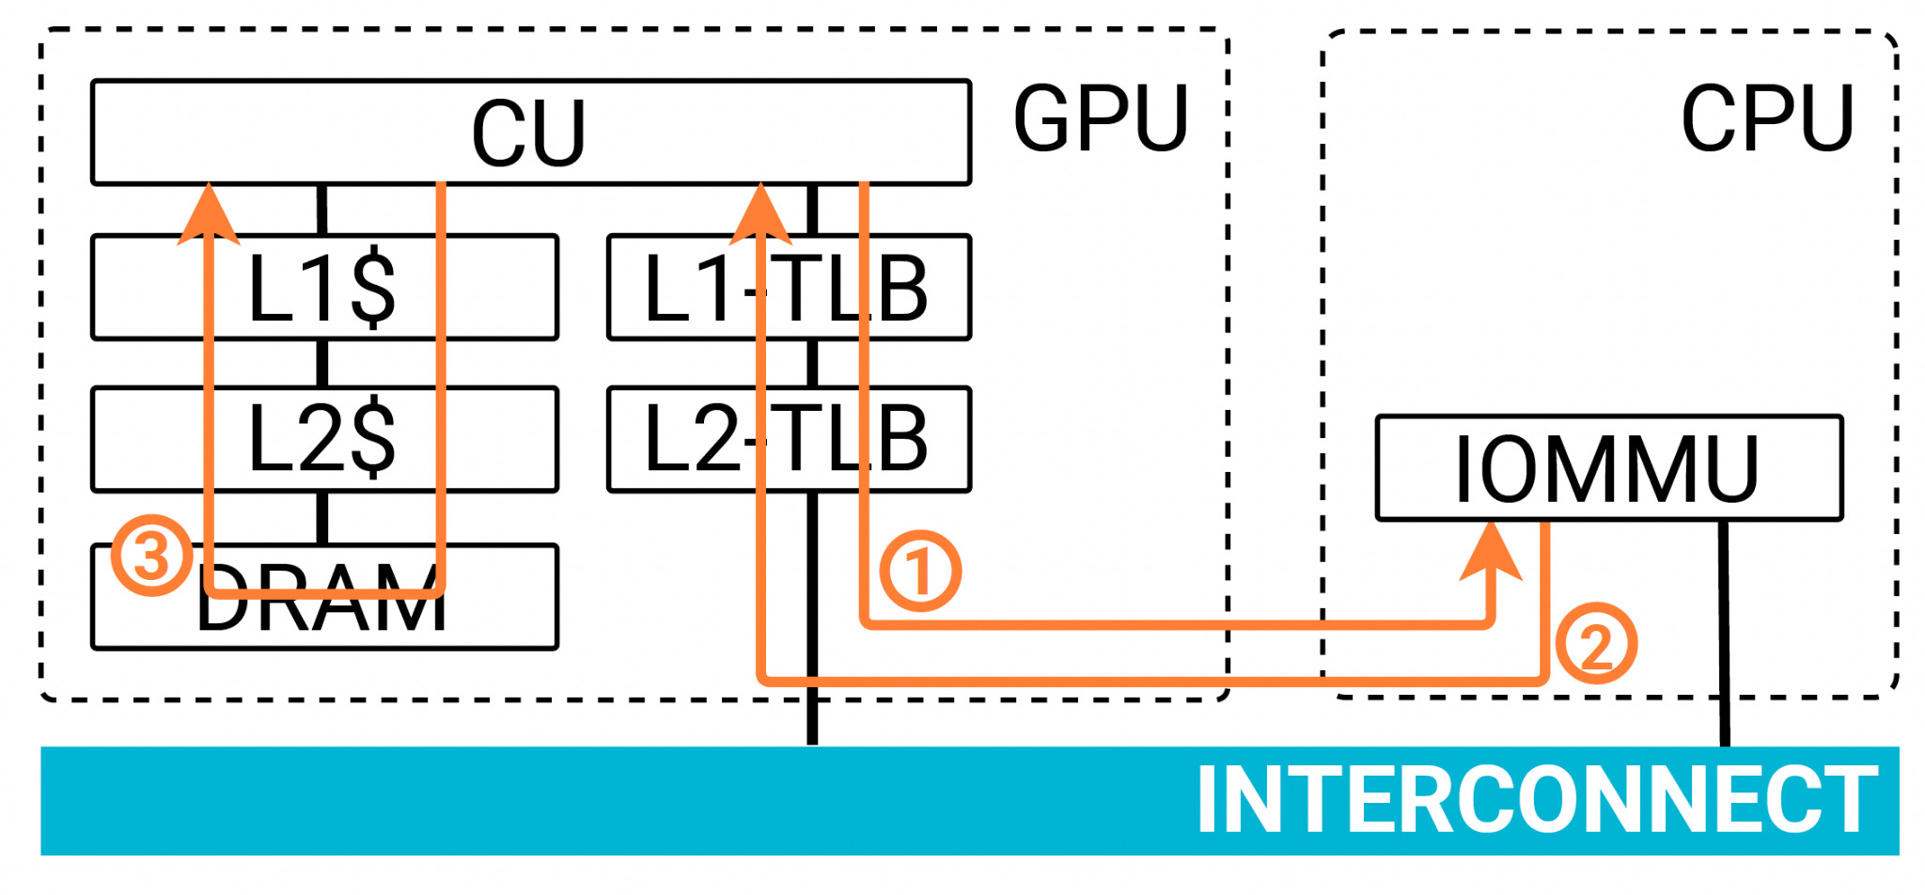
Introduction to GPU Virtual Memory
Virtual Memory in Heterogeneous CPU-GPU architectures
L1-TLB → per-CU
L2-TLB → per-GPU
L3-TLB → per-GPU (in gem5)
757 Project: TLB Prefetcher for Inter-CU Locality Exploitation
Image Source: [Baruah et. al PACT’20] Valkyrie
Notes:
On a translation request from the CU, if it misses in both L1 and L2 TLB, the request is forwarded to the page walk buffer on the IOMMU located on the CPU die.
One a HW page table walker is available - the page table walk is performed and the TLBs are filled

Slide 5
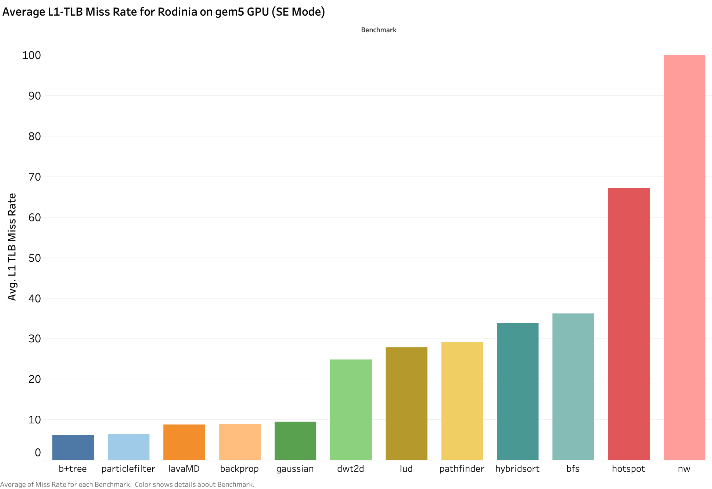
Is Virtual Memory Performance Important?
# L1 TLBs | 64
L1 TLB size | 32 entries
# L2 TLBs | 1
L2 TLB size | 4096 entries
757 Project: TLB Prefetcher for Inter-CU Locality Exploitation

Slide 6
Outline
Introduction
Virtual Memory in GPUs
Motivation and Background
Valkyrie: Exploiting Inter-TLB locality
Methodology
Results
Summary and Project Learnings
757 Project: TLB Prefetcher for Inter-CU Locality Exploitation
Notes:
Now that Lipika has introduced VIrtual memory for GPUs, I’ll talk about one particular solution for improving TLB performance in GPUs that was proposed in a PACT 2020 paper called Valkyrie

Slide 7
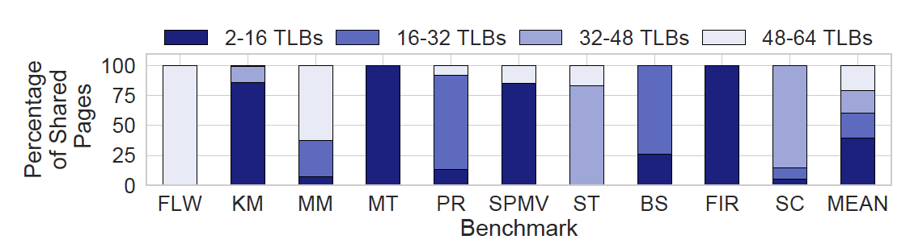
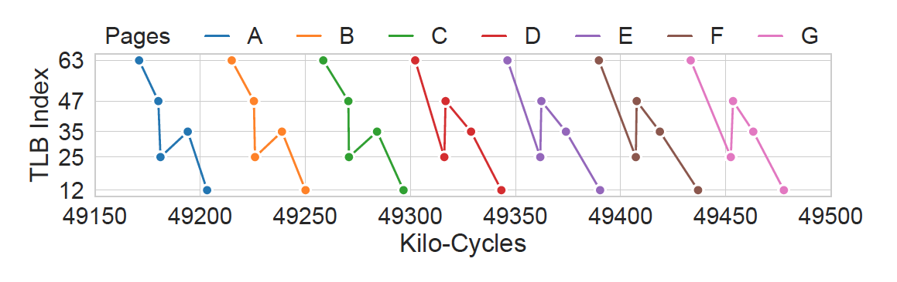
Background: Valkyrie
Observation 1
Lots of page sharing amongst per-CU L1-TLBs
Observation 2
Temporal locality in translation accesses
⇒ potential to prefetch entries to increase L1-TLB hit rate
757 Project: TLB Prefetcher for Inter-CU Locality Exploitation
Image Source: [Baruah et. al PACT’20] Valkyrie
Notes:
The motivation for Valkyrie came from 2 key observations when they analyzed different workloads running on GPUs. The first observation was that in a representative set of workloads, there is a lot of page sharing amongst per-CU L1-TLBs. They further analyzed the workloads to examine the nature of this page sharing.

Slide 8
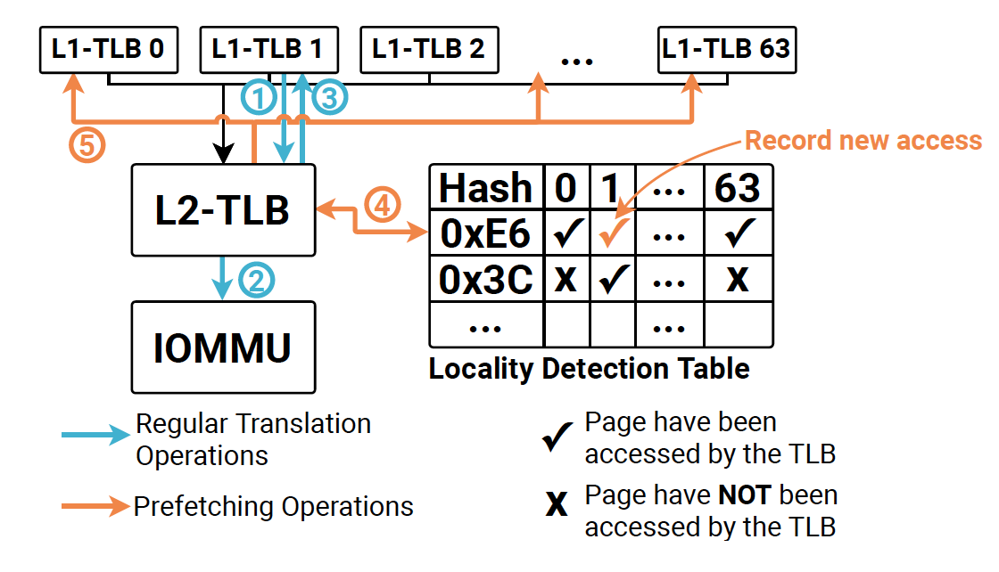
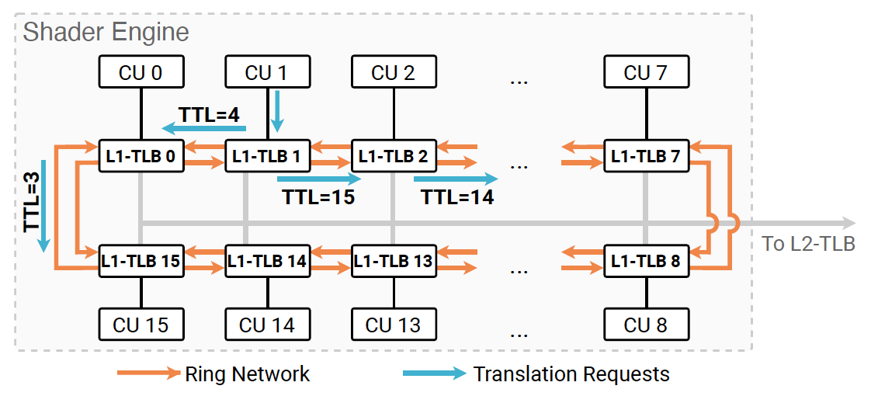
Valkyrie: Proposed System Design
Prefetching for temporal locality
Interconnect probing for spatial locality
757 Project: TLB Prefetcher for Inter-CU Locality Exploitation
Image Source: [Baruah et. al PACT’20] Valkyrie

Slide 9
Objectives
Understand the gem5 Memory Management Unit (MMU).
Identify scope for improvements in modeling TLB translation latencies in System Emulation (SE) mode.
Replicate the Valkyrie prefetcher on gem5 .
Evaluate the performance impact of the Valkyrie implementation on gem5.
757 Project: TLB Prefetcher for Inter-CU Locality Exploitation
Notes:
because the original paper implemented it on MGPUSim.

Slide 10
Valkyrie: Details and Shortcomings
Prefetching + Probing: Destructive Interference
Entries evicted from TLB-X by prefetching mechanism could be potentially useful to other TLBs probing X vis interconnects.
Valkyrie proposes using separate victim buffers or prefetch buffers, at the cost of area and power overheads. This also adds complexity to L1-TLB lookup (parallel lookup with buffer required )
Sensitivity to TLB sizes
Valkyrie evaluated with 128- and 64-entry L1-TLBs (all their benchmarks had large memory footprints allowing for reuse)
757 Project: TLB Prefetcher for Inter-CU Locality Exploitation

Slide 11
Outline
Introduction
Virtual Memory in GPUs
Motivation and Background
Valkyrie: Exploiting Inter-TLB locality
Methodology
Results
Summary and Project Learnings
757 Project: TLB Prefetcher for Inter-CU Locality Exploitation

Slide 12
Methodology
The Valkyrie paper was evaluated using MGPUSim (written in Go)
PICLE uses gem5 instead
Gem5 is an event driven simulation methodology that contains GPU models which implement AMD’s GCN3 ISA.
Understand the gem5 Memory Management Unit (MMU).
757 Project: TLB Prefetcher for Inter-CU Locality Exploitation
Notes:
Now that we’ve seen how this prefetcher should work, we need to evaluate the idea. The easiest way to do so is to prototype it in a simulator. The original Valkyrie paper used MGPUSim which is written in Go. Since Go requires a steep learning curve, we decided to use gem5 since C++ is familiar. Gem5 is an event driven simulation methodology that contains GPU models which implement AMD’s GCN3 ISA. We started by diving into a study of this GPU model to understand its memory management unit before implementing our prefetcher.

Slide 13
LDT (ClockedObject)
Functions
Sub Classes
update()
lookup()
process()
LDTEntry
TLBSideRequestPort
Updates the locality detection table with the virtual address and the list of CUs that accessed it
Uses LRU to evict old entries
Checks the locality detection table and sends the translation entry to respective CUs
Schedules either update() or lookup() after a certain number of cycles upon receiving the request from L1/L2
Stores the virtual address and list of CUs that accessed it in the past
Interface to send translation to L1 TLB
TLBSideResponsePort
Interface for requests from TLB
757 Project: TLB Prefetcher for Inter-CU Locality Exploitation
Notes:
The main component in the prefetcher is the locality detection table or LDT. This was modelled as a class with functions for update and lookup. Updates are triggered when L1 accesses a page and Lookups are triggered when L2 evicts a translation entry. Additionally, a function called process scheduled events to trigger update and lookup when it receives the respective requests from TLB. The class also has other members to model the LDT entries and ports.

Slide 14
gem5
src/arch/amdgpu/common
src/configs/common
src/mem
tlb.hh, tlb.cc
ldt.hh, ldt.cc
LDT.py
GPUTLBConfigs.py
request.hh
Added Request, Response ports in L1 to interface with LDT for updates
Added Request port in L2 to issue lookups in LDT
Created new classes LDT, LDTEntry to model LDT.
Updates table on page accesses at L1
Sends TLB entry to relevant CUs when page is evicted at L2
Python class to define LDT configuration parameters
Top-level configuration file that creates instances of TLBs and connects them
Added connections between TLB and LDT
Added getVaddr()
X86GPUTLB.py
Updated to expose new ports in TLB
757 Project: TLB Prefetcher for Inter-CU Locality Exploitation
Notes:
This here is a panoramic snapshot of all the changes we made. After modeling the LDT, we added ports in TLB to connect to the prefetcher. We then made the connections between TLB and LDT in the top level GPU TLB configuration file. We decided to interface the prefetcher with the L2 level instead of the last level TLB to get maximum use. There are a few other changes that are shown on the slide, but the ones I mentioned are the most important.

Slide 15
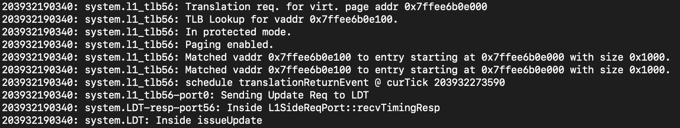
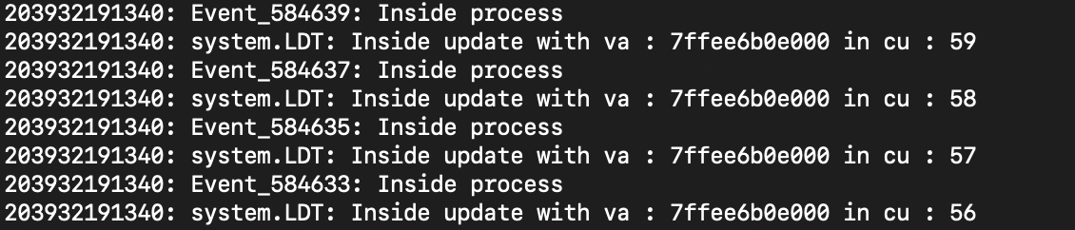
LDT Update
757 Project: TLB Prefetcher for Inter-CU Locality Exploitation
Notes:
We functionally verified the prefetcher using a simple test called square that works on large 1D arrays. The trace files shown here demonstrate the prefetcher’s execution. The image on the top shows how L1 TLB sends update requests to the locality detection table when it accesses a page and the image below shows how the table gets updated.

Slide 16
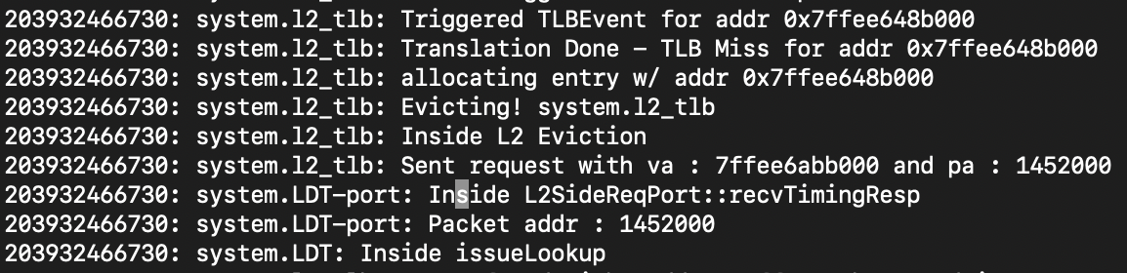
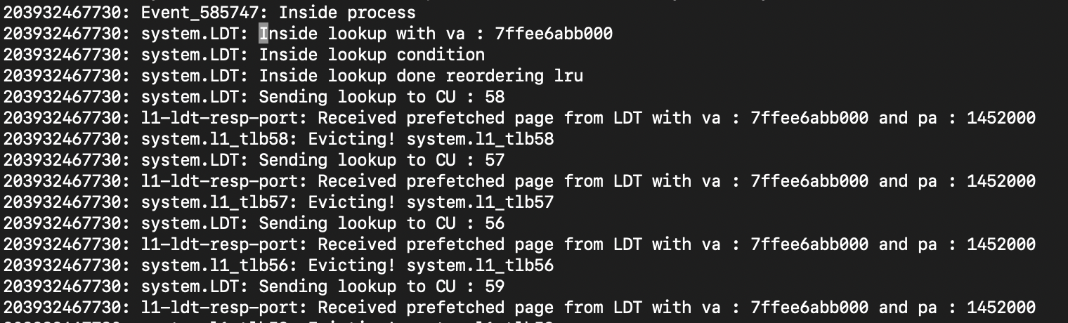
LDT Lookup
757 Project: TLB Prefetcher for Inter-CU Locality Exploitation
Notes:
The images here show how table lookups are done. The image on the top shows an L2 TLB entry being evicted and the lookup associated with it being issued. The image below shows the lookup being done for this page and the translation sent to all CUs that accessed it in the past.

Slide 17
Experimental design
Accuracy of modeling virtual memory
Benchmark results
757 Project: TLB Prefetcher for Inter-CU Locality Exploitation

Slide 18
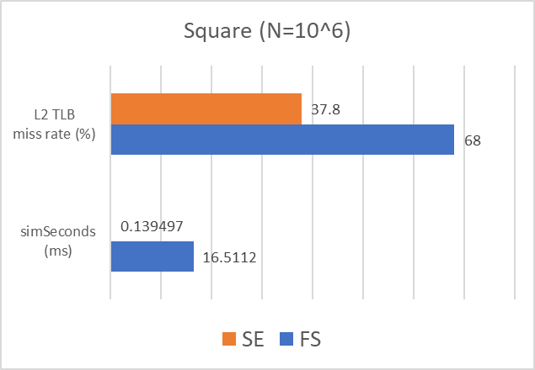
Experimental design: Modeling virtual memory
gem5 SE | gem5 Full System GPU (relatively new)
TLB and PTW are modeled with annotations | More precisely models TLB and PTW
Shorter simulations, easier design exploration | Long simulations, difficult to debug/experiment
We made sure that the TLB miss latency is modelled to be the same value between FS and SE!
757 Project: TLB Prefetcher for Inter-CU Locality Exploitation

Slide 19
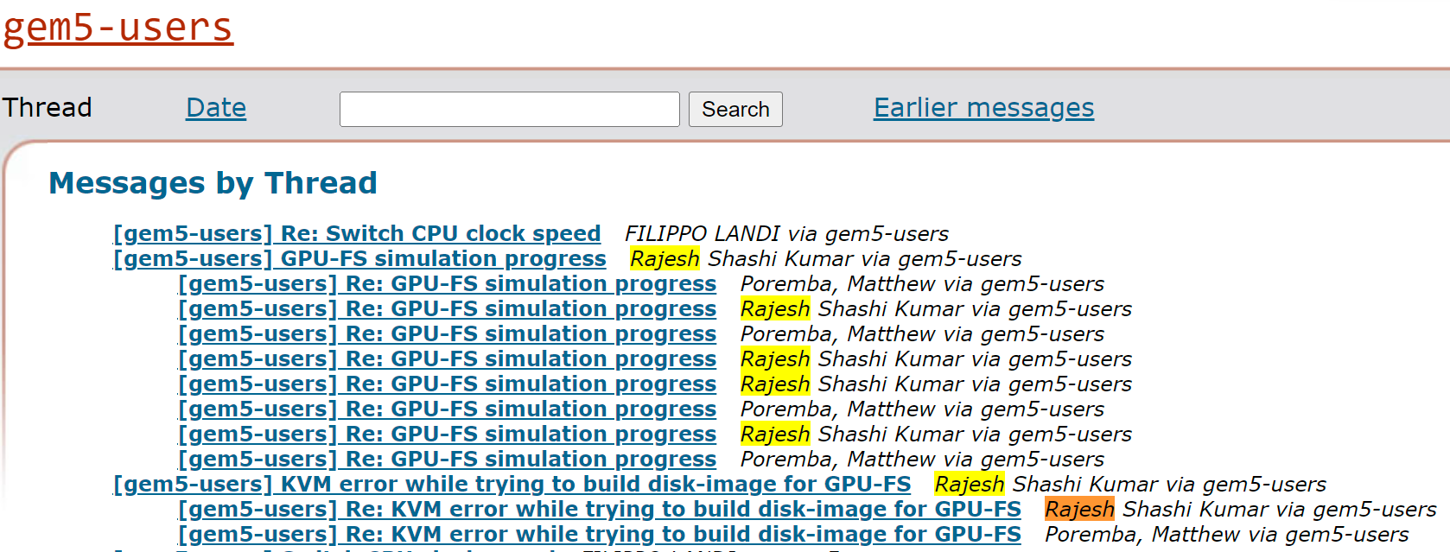
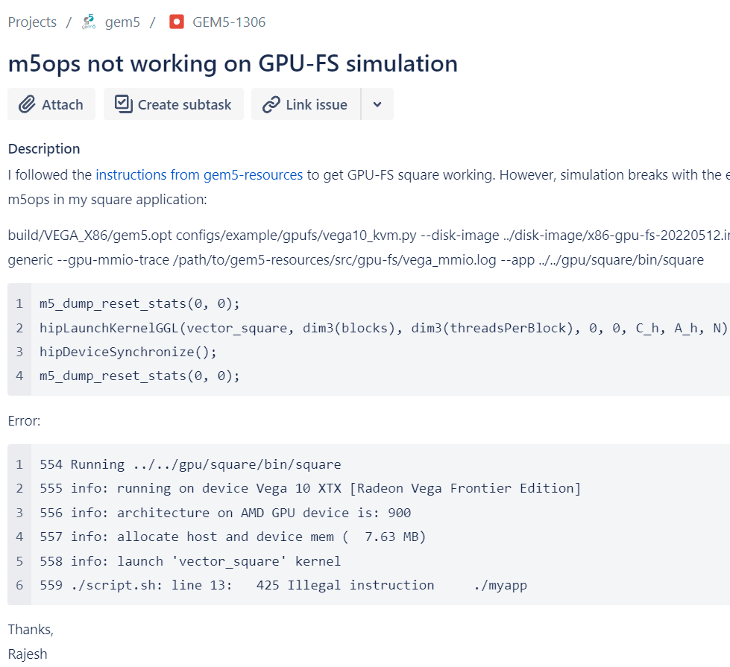
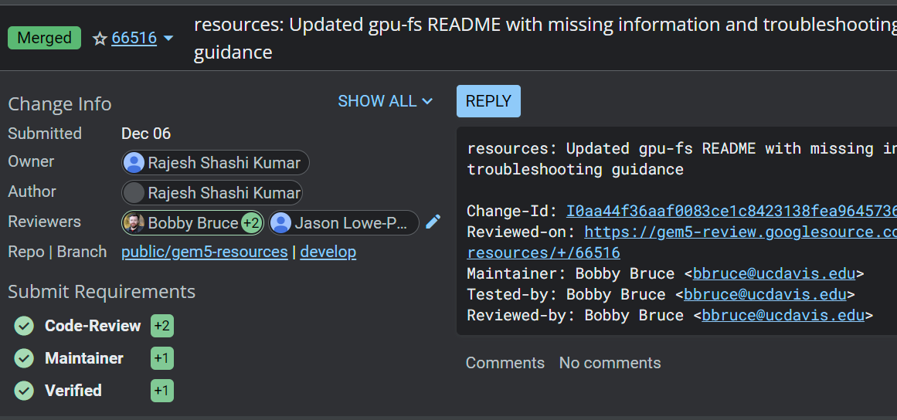
Experimental design: FS bring-up contributions
Mailing list exchanges
3. Reported a bug
2. Merged PR

Slide 20
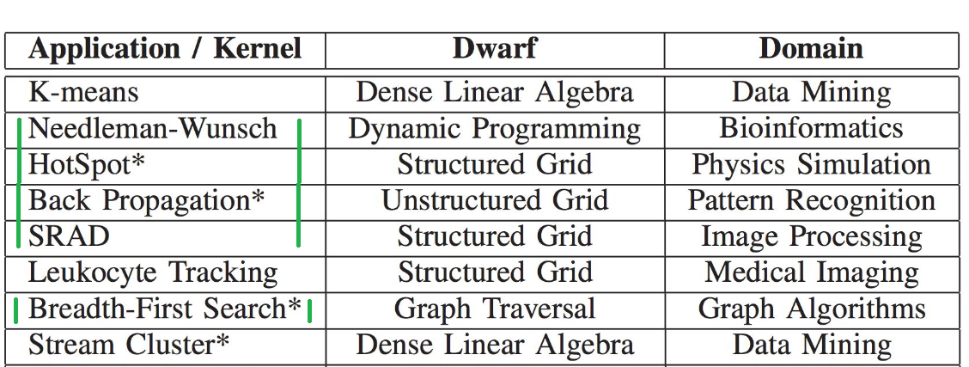
Experimental design: Benchmarks
Square: Microbenchmark that computes C[i] = A[i] * A[i]
Rodinia: Benchmark suite for diverse parallel heterogeneous computing
Excluded workloads:
Long runtime(huffman,h3D, streamcluster,cfd)
Lack of texture support in gem5 (kmeans, leukocyte, heartwall)
757 Project: TLB Prefetcher for Inter-CU Locality Exploitation

Slide 21
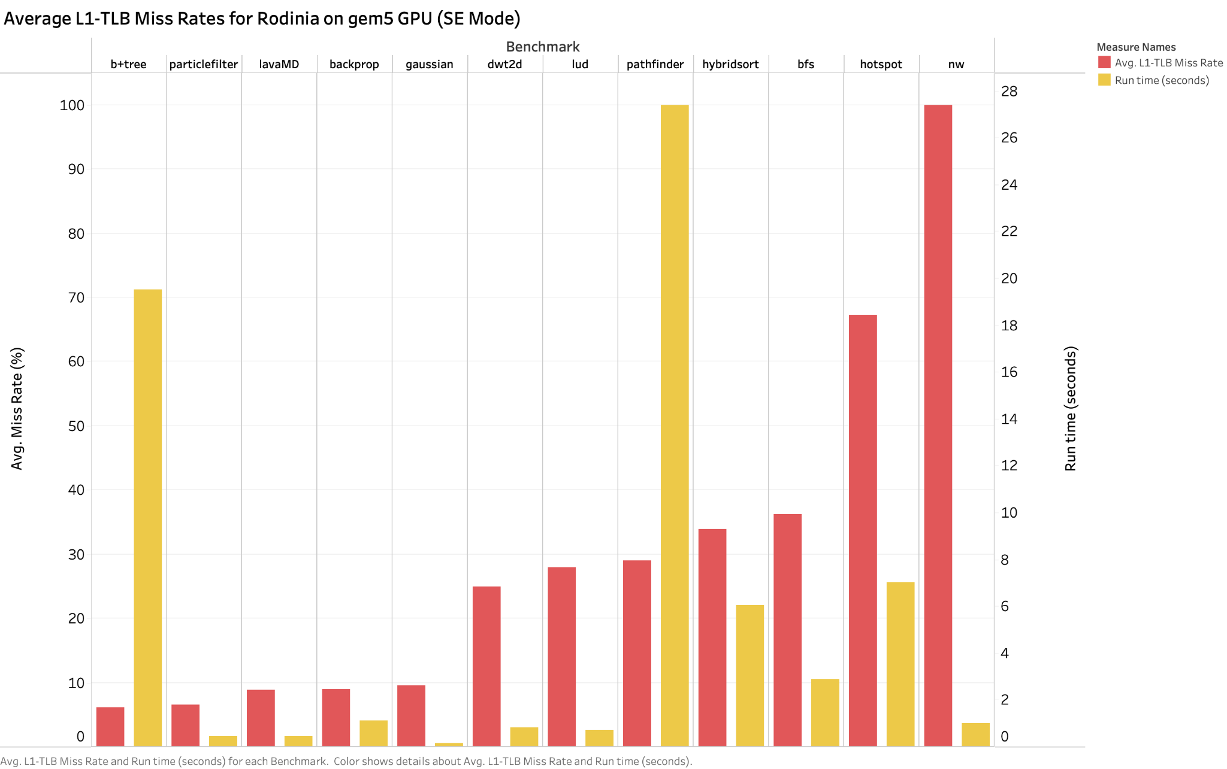
Results: Baseline (Miss rate and execution time)
# L1 TLBs | 64
L1 TLB size | 32 entries
# L2 TLBs | 1
L2 TLB size | 4096 entries
757 Project: TLB Prefetcher for Inter-CU Locality Exploitation
Notes:
It is off the critical path

Slide 22
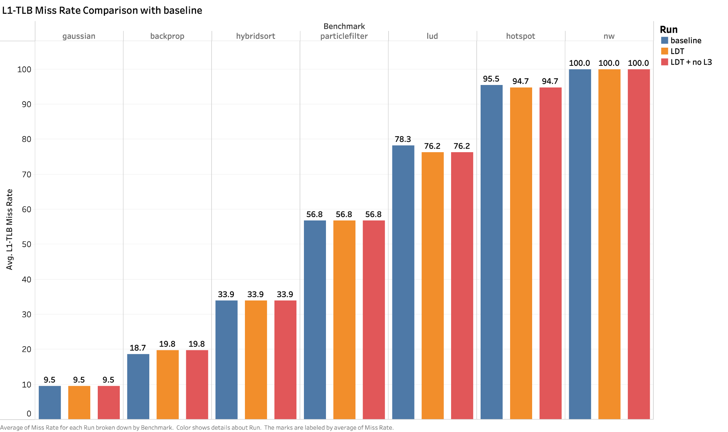
Results (Rodinia)
+0.8%
# L1 TLBs | 64
L1 TLB size | 4 entries
# L2 TLBs | 1
L2 TLB size | 16 entries
2.4%
2.3%

Slide 23
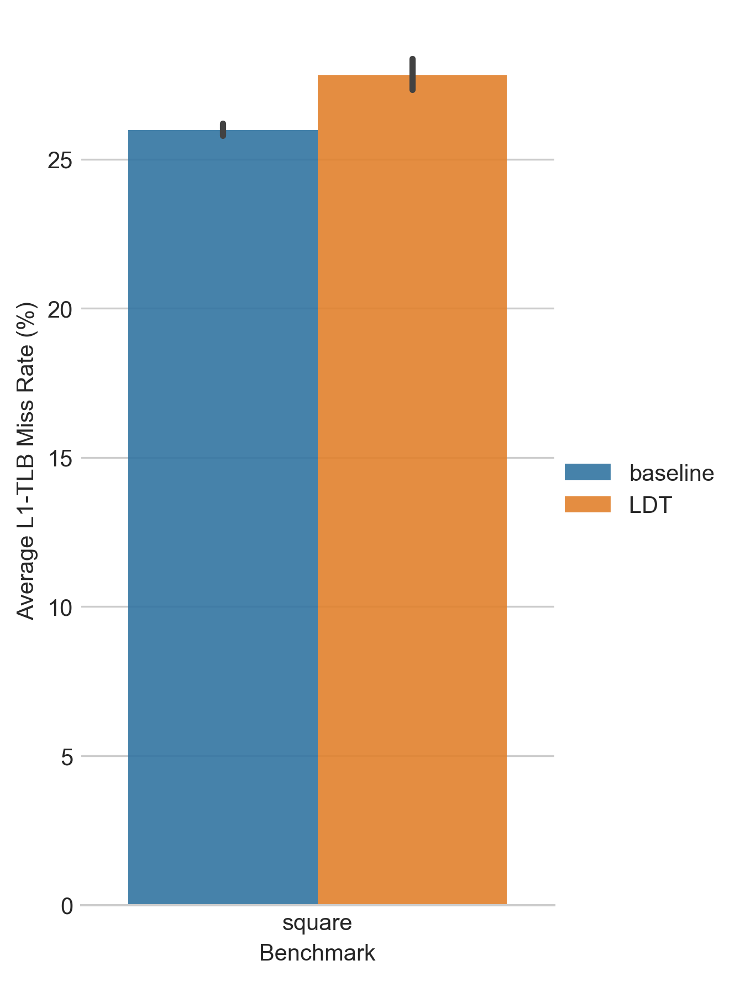
Results (Square)
# L1 TLBs | 64
L1 TLB size | 4 entries
# L2 TLBs | 1
L2 TLB size | 16 entries
757 Project: TLB Prefetcher for Inter-CU Locality Exploitation

Slide 24
Summary
Questions?
There is some scope for hardware optimizations for virtual memory in GPUs, but the benefits we get are heavily dependent on applications’ memory footprint and system configuration.
Learnings
Prototyping new hardware features using a simulator.
Porting benchmarks to work with different gem5 simulation modes (System Emulation and Full System).
Importance of good documentation — lack of useful documentation on virtual memory support in gem5 slowed us down.
Benchmark selection is important.
Targeting common case first — probing vs prefetching.
757 Project: TLB Prefetcher for Inter-CU Locality Exploitation

Slide 25
Future Work
Future Work
Implement Valkyrie prober by implementing interconnects.
Carry out design space exploration for the LDT to improve performance.
Expand implementation to MCMGPUs when gem5 support is available.
757 Project: TLB Prefetcher for Inter-CU Locality Exploitation

Slide 26
Backup Slides

Slide 27
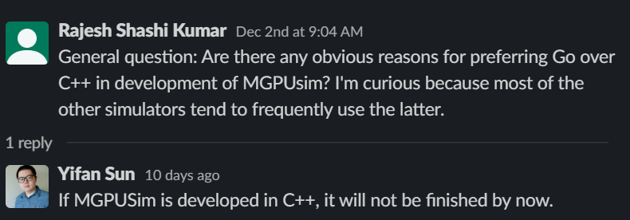
Experimental design: GPU Simulator
MGPUSim (Popular for recent GPU work) | gem5 (Active community for GPU work)
Models AMD GCN3 ISA | Models AMD GCN3, VEGA ISA (newer)
Modeling in Go, steep learning curve | Modeling in C++. Lower initial cost.
Does not have FS support | Supports FS and SE modes
757 Project: TLB Prefetcher for Inter-CU Locality Exploitation

Slide 28
Project Timeline
Implement Valkyrie prober by implementing interconnects.
Carry out design space exploration for the LDT to improve performance.
Expand implementation to MCMGPUs when gem5 support is available.
Literature Survey of Virtual Memory in GPU.
Implement Valkyrie on gem5.
Improve Valkyrie probing by implementing ring interconnect.
Expand Valkyrie implementation to MCMGPUs.
Ramped-up on gem5 ecosystem.
Setup appropriate benchmarks and got them to work on gem5 GPU SE mode.
Established the GPU TLB latency model used in gem5.
October
December
September
November
Future Work
Implementation of MCMGPUs because gem5 doesn’t have support for inter-chiplet communication.
Model TLB latencies because there was no relevant documentation in gem5 w.r.t this.
Added LDT model in gem5.
Integrated the model into the TLB hierarchy.
Did functional testing to verify correctness.
Did performance testing using Rodinia benchmarks.

